Slide 1


GOOD
CABS
Presented by: Kanchan Sinha

Slide 2

OVERVIEW
01
02
03
About Us
Problem Statement
Data set & Model
04
05
06
Business Request
Primary & secondary Analysis
Key Insights & Recommendations

Slide 3

ABOUT US
Goodcabs, a cab service company focused on tier-2 cities, supports local drivers in earning sustainable livelihoods while delivering excellent passenger service. It started operating in 2022 and is currently operating in ten cities across India.

Slide 4

PROBLEM STATEMENT
Goodcabs has set ambitious performance targets for 2024 to drive growth and enhance passenger satisfaction. To support this initiative, the management team assigned the data analyst team the task of assessing key metrics, including trip volume, repeat passenger rate, passenger satisfaction, and the balance between new and repeat passengers.
With the urgency of the request from Chief of Operations Bruce Haryali and the unavailability of the analytics manager, Tony, the responsibility given to me. As the company’s data analyst, I am tasked with managing primary, secondary and business requests to deliver actionable insights.

Slide 5

Data Set
Datasets provided by the company:
Trips_db
Target_db
External data source and assumptions:
Used statisticstimes.com to find the population of the given cities.
Categorized cities into:
Business-focused: Lucknow, Coimbatore, Indore, Vadodara, Surat, and Chandigarh
Tourism-focused: Jaipur, Kochi, Mysore, and Visakhapatnam
Note: Data Set used in this project from Jan 2024 to June 2024.

Slide 6
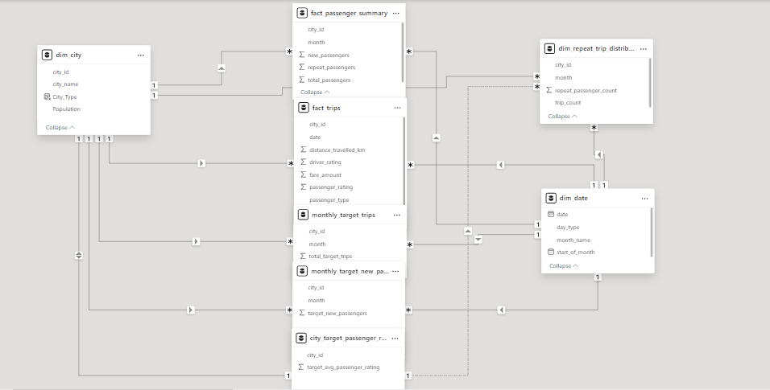
Data Model

Slide 7

BUSINESS REQUESTS

Slide 8
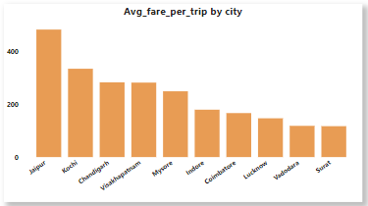
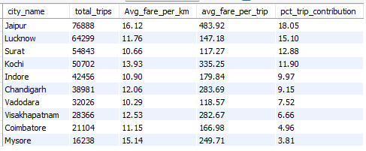
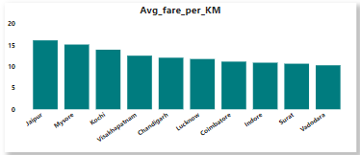
Business Request - 1: City-Level Fare and Trip Summary Report

Slide 9
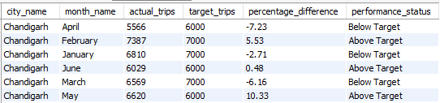
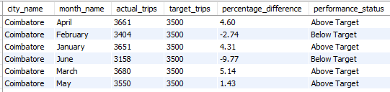
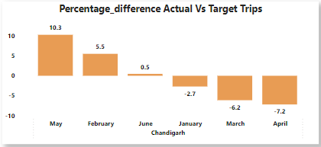
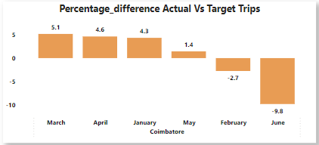
Business Request - 2: Monthly City-Level Trips Target Performance Report
Chandigarh
Coimbatore

Slide 10
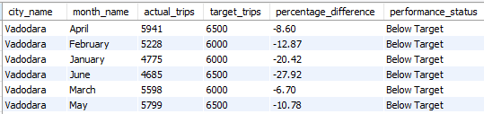
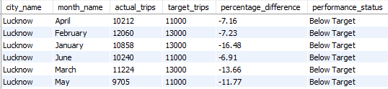
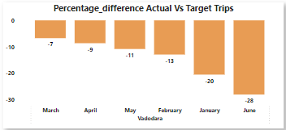
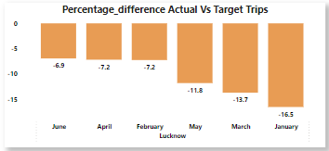
Vadodara
Lucknow

Slide 11
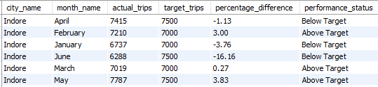
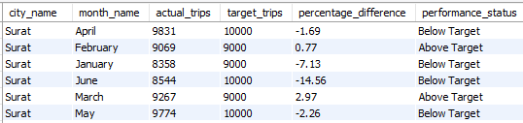
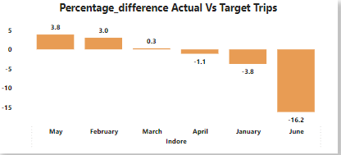
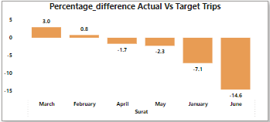
Indore
Surat

Slide 12
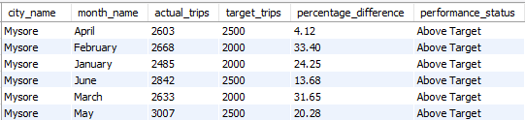
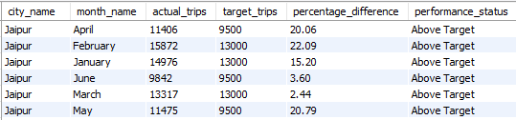
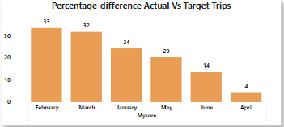
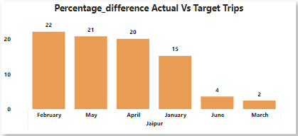
Mysore
Jaipur

Slide 13
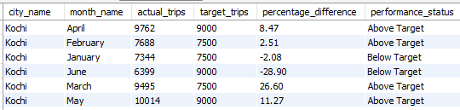
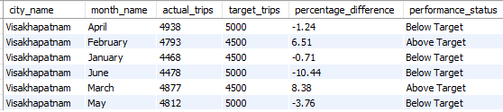
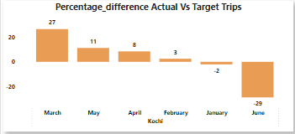
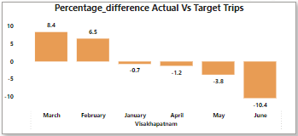
Kochi
Visakhapatnam

Slide 14
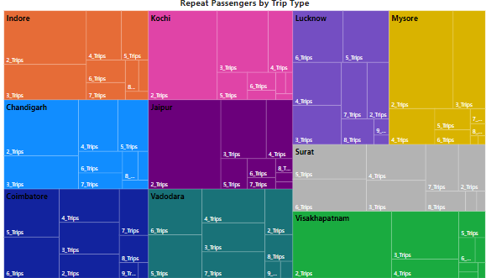
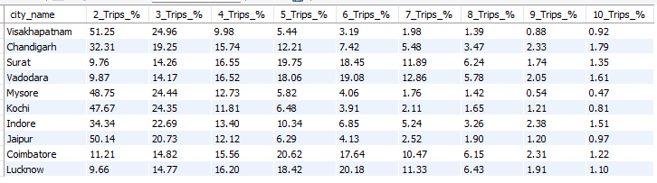
Business Request - 3: City-Level Repeat Passenger Trip Frequency Report

Slide 15
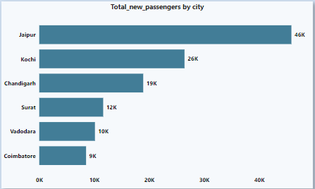
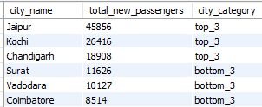
Business Request - 4: Identify Cities with Highest and Lowest Total New Passengers

Slide 16
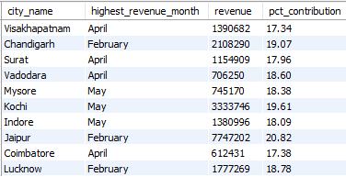
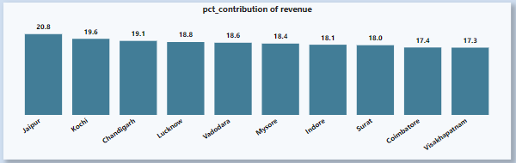
Business Request - 5: Identify Month with Highest Revenue for Each City

Slide 17
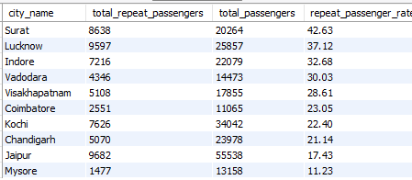
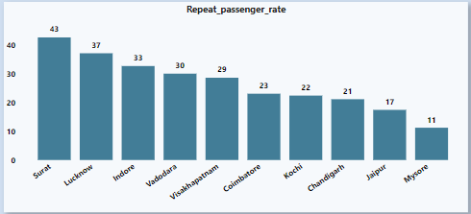
Business Request - 6: Repeat Passenger Rate Analysis

Slide 18
PRIMARY ANALYSIS

Slide 19
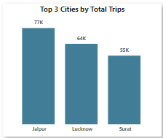
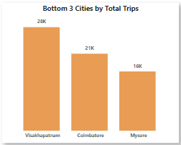
1. Top and Bottom Performing Cities by Total Trips
Insights:
Top 3 cities: Jaipur, Lucknow, Surat
Bottom 3 cities: Visakhapatnam, Coimbatore, Mysore

Slide 20
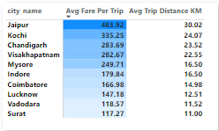
2. Average Fare per Trip by City
Insights:
Jaipur has the longest average trip distance at 30.02 km, aligning with its highest fare.
Surat has the shortest average trip distance at 11 km, which correlates with its lowest fare.
Indore and Mysore both have an average trip distance of 16.5 km, but Mysore's average fare per trip is significantly higher (₹249.71 vs. ₹179.84). This difference could be due to factors like higher base fares, service premiums, or city-specific costs(Fuel cost & toll tax).

Slide 21
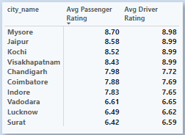
3. Average Ratings by City and Passenger Type.
Insights:
There is a positive correlation between average passenger ratings and average driver ratings.

Slide 22
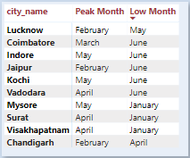
4. Peak and Low Demand Months for each City by Total Trips.
Insights:
For most of the cities-
Peak Month : February & April
Low Month : June

Slide 23
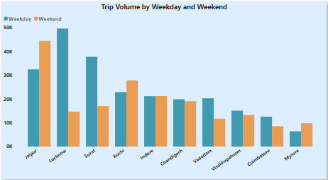
5. Weekend vs. Weekday Trip Demand by City
Insights:
Lucknow records the highest trip volume on weekdays, while Jaipur leads in trip volume on weekends.
Lucknow and Surat are the cities with a significant variation in trip volume between weekdays and weekends.

Slide 24
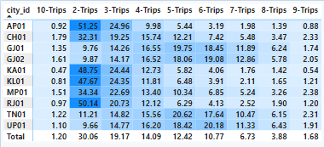
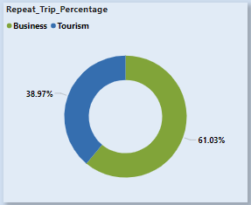
6. Repeat Passenger Frequency and City Contribution Analysis

Slide 25
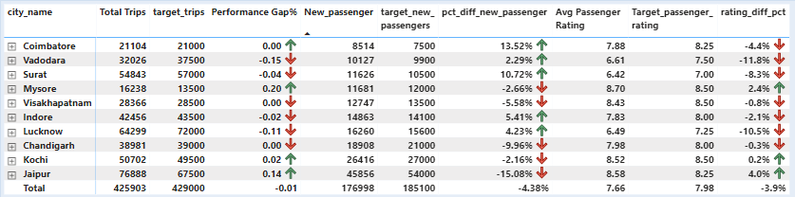
7. Monthly Target Achievement Analysis for Key Metrics.

Slide 26
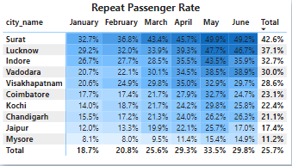
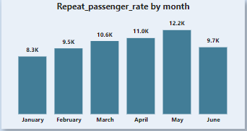
8. Highest and Lowest Repeat Passenger Rate (RPR%) by City and Month.
Surat and Lucknow have the highest repeat passenger rates, while Jaipur and Mysore have the lowest repeat passenger rates.
May has the highest repeat passenger rate, while January has the lowest.

Slide 27
SECONDARY ANALYSIS

Slide 28
Factors Influencing Repeat Passenger Rates
What factors (such as quality of service, competitive pricing, or city demographics) might contribute to higher or lower repeat passenger rates in different cities? Are there correlations with socioeconomic or lifestyle patterns in these cities?
Quality of Service
Timeliness and Reliability: Consistent, on-time service encourages repeat usage, especially in business-focused Cities.
Price Competitiveness:
Cities with multiple transport options see higher repeat rates when pricing is attractive compared to alternatives.
Demographic factors:
Larger, densely populated cities see more repeat passengers due to frequent travel needs.
Age and Income: Younger and higher-income groups tend to use premium services more frequently.
Repeat rates are often higher in wealthier, business cities with young populations or those where commuting is a daily necessity. Understanding these patterns allows to adapt and boost repeat passenger rates.

Slide 29
2. Tourism vs. Business Demand Impact:
How do tourism seasons or local events (festivals, conferences) impact Goodcabs' demand patterns? Would tailoring marketing efforts to these events increase trip volume in tourism-oriented cities?
Impact of Tourism Seasons and Local Events:
Tourism Peaks: Cities with high tourist traffic see demand spikes during peak seasons and local events like festivals or national holidays.
Local Events: Conferences and festivals also drive demand, with business travelers and tourists needing rides to specific venues.
Tailoring Marketing Efforts:
Targeted Promotions: Offering event-specific discounts or services for tourists and business travelers can boost demand.
Effect on Trip Volume:
Tailoring marketing efforts to these events can significantly increase Goodcabs’ trip volume in tourism-heavy cities, while optimizing resources during peak times ensures higher service availability.

Slide 30

3. Emerging Mobility Trends and Goodcabs' Adaptation
What emerging mobility trends (such as electric vehicle adoption, green energy use) are impacting the cab service market in tier-2 cities? Should Goodcabs consider integrating electric vehicles or eco-friendly initiatives to stay competitive?
As electric vehicle (EV) adoption and green energy initiatives rise, tier-1 cities, which are grappling with heavy pollution. Tier-2 cities are also experiencing increased interest in eco-friendly mobility.
Goodcabs could benefit by integrating EVs into their fleet, appealing to eco-conscious customers in both city types.
Additionally, adopting eco-friendly practices, such as carbon-neutral rides, would help differentiate Goodcabs in the market, attract new customers, and align with sustainability goals, ensuring competitiveness in the evolving transportation landscape.

Slide 31

4. Partnership Opportunities with Local Businesses
Are there opportunities for Goodcabs to partner with local businesses (such as hotels, malls, or event venues) to boost demand and improve customer loyalty? Could these partnerships drive more traffic, especially in tourism-heavy or high-footfall areas?
Offer exclusive ride packages for corporate booking and integrate them with loyalty programs.
Provide sightseeing packages, work with travel agencies, and offer airport transfers.
Goodcabs could collaborate with state-specific cab / auto service providers, such as Kerala Savari in Kerala and Namma Yatri in Karnataka (now expanding to other states), to promote and support local drivers.

Slide 32
5. Data Collection for Enhanced Data-Driven Decisions
To make Goodcabs more data-driven and improve its performance across key metrics (Such as repeat passenger rate, customer satisfaction, new passengers and trip volume), what additional data should Goodcabs collect? Consider data that could provide deeper insights into customer behaviour, operational efficiency, and market trends.
To improve Goodcabs' data-driven decisions, the company should prioritize collecting the following key data:
Customer Feedback Analysis: Ratings and reviews on trip experiences to understand satisfaction and pain points.
Customer Demographics: Information such as age, income, and travel habits to tailor services and improve personalization.
Competitor Analysis: Market share, pricing strategies, and promotions from competitors can provide valuable insights into market trends and help Goodcabs adapt to changes.
Driver Performance & Behavior: Metrics on driver ratings, response times, and efficiency to enhance service quality.

Slide 33
Recommendations
Jaipur and Kochi may explore premium or executive cab services, considering their longer distance trends and high fare.
Low Fare, Short Distance: Cities like Surat and Vadodara could benefit from targeting customers with bundled trip packages or loyalty programs to increase overall trip volumes.
Vadodara, Lucknow, and Surat have driver and passenger avg ratings below 7. The company should focus on improving services in these cities to enhance customer satisfaction.
Jaipur and Mysore have the lowest repeat passenger rates, indicating a need for strategies to improve customer retention in these cities. The company should consider implementing loyalty programs, offering personalized promotions, or improving the overall customer experience to encourage repeat bookings

Slide 34
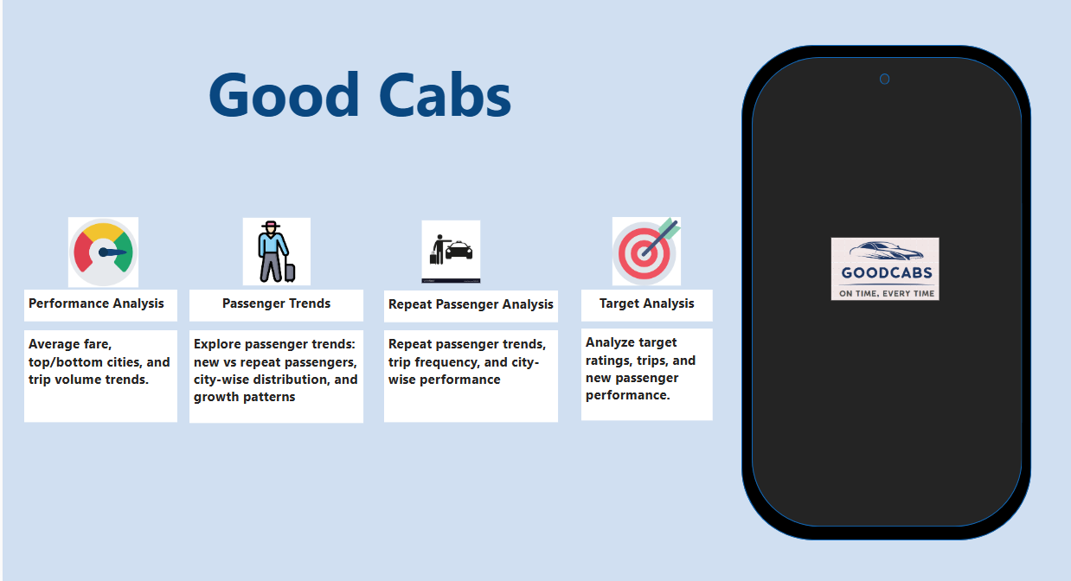

Slide 35
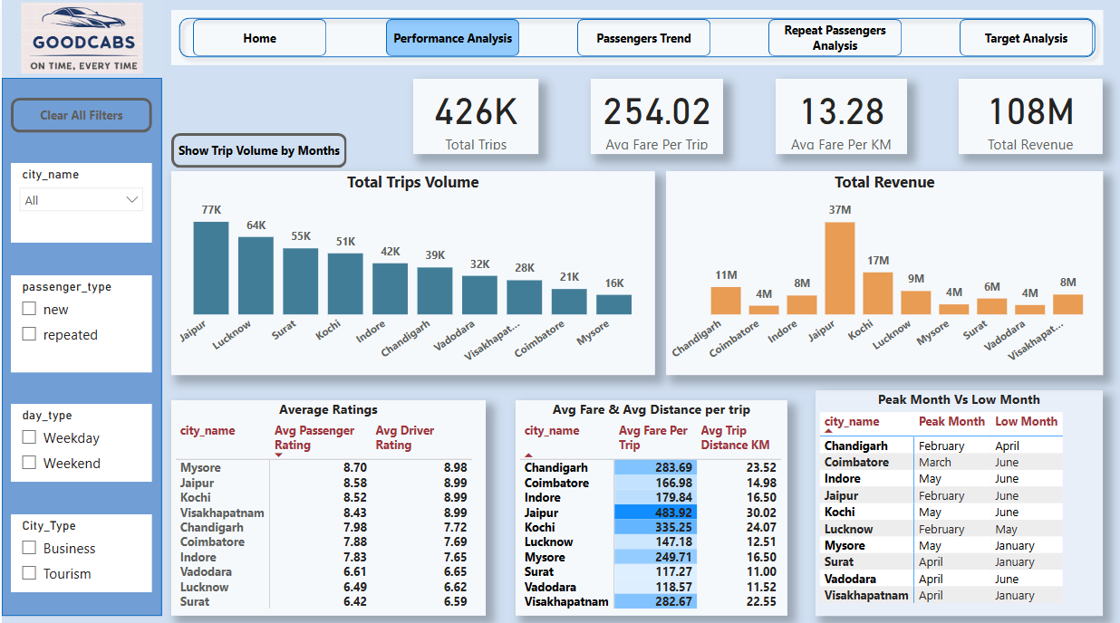

Slide 36
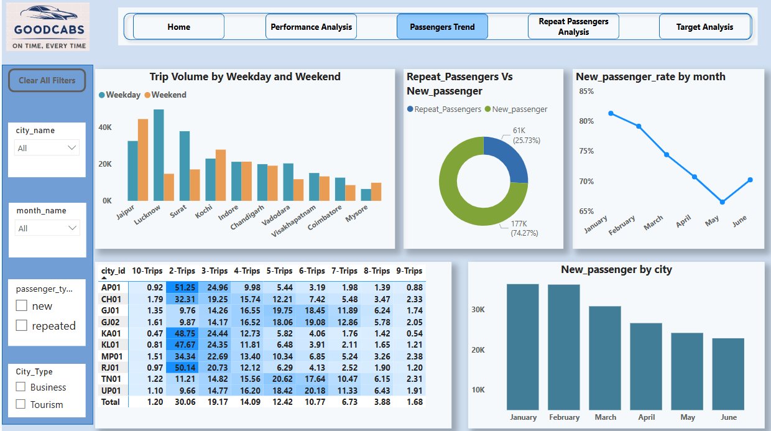

Slide 37
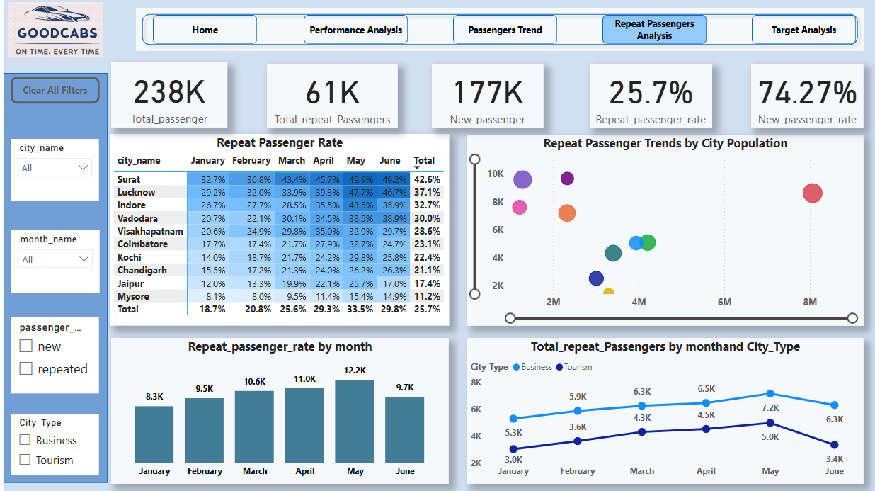

Slide 38
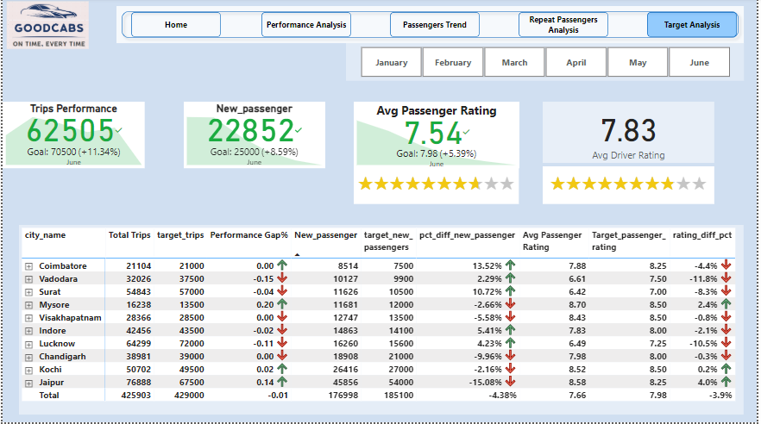

Slide 39




Thank You
Connect with me.

